Slide 1


Is Gun Violence Distinctly an American Problem?
David Meiners
Bellevue University
Summer 2021

Slide 2
Introduction
Media reporting on gun violence has increased in recent decades in the United States
The issue is often portrayed as distinctly an American problem
Data supports an upward trend in gun violence in the United States, especially for gun related homicides
This analysis will compare the United States to other countries in the world to understand if gun homicides can be reduced by enacting new policies

Slide 3
Data Sources
Homicide Rate - includes international firearm related homicide statistics which were compiled by the United Nations Office on Drugs and Crime. The UNODC is the worldwide leader in data collection for statistics on drugs and crime and provides a reliable source for data collection quality
Guns Per Capita – provides the number of firearms that exist in a country per capita. Data was compiled and published on Wikipedia through open-source community contributions and references sources where the data was derived from.
Guns Regulations Per Country – elaborates on various gun control regulations which exist in a country. Data was compiled and published on Wikipedia through open-source community contributions and references sources where the data was derived from.

Slide 4
Research Questions
Are there countries that have a higher rate of homicide while outlawing the use of handguns and Semi-Automatic weapons?
Does banning open carry and concealed firearms reduce the rate of homicides?
Do the number of guns which exist per capita directly correlate to the rate of homicides which occur?
Are gun related homicides distinctly an American problem when compared to other countries with similar policies?

Slide 5
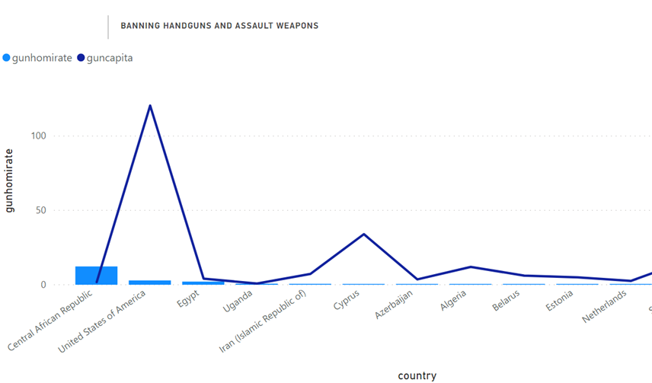
Are there countries with higher rate of homicides that ban certain types fo weapons?
The United States has a higher rate of homicides than most countries which ban these type of weapons
There is one outlier that has a higher rate of homicides by firearm than the United States
This can be explained by an inability to enforce the regulations in the Central African Republic

Slide 6
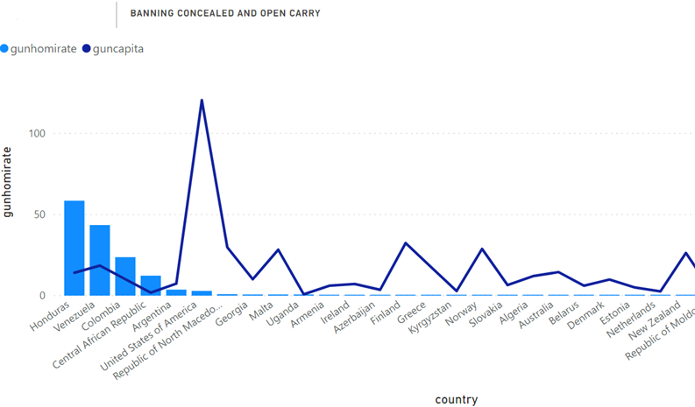
Does banning open and concealed Carry result in a lower rate of homicides?
The United States often has a higher rate of homicides when compared to countries that ban carrying firearms.
There are again a few countries with higher rates than the United States even with the bans
The countries with a higher rate could be explained by an inability to enforce the regulations as well

Slide 7
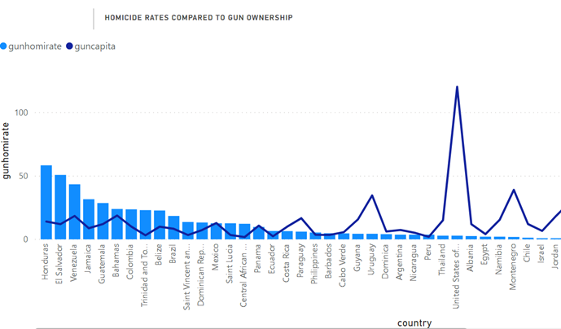
Do the number of guns per capita correlate with a higher rate of homicides?
The United States has the most guns per capita than any other country in the world
There are several countries with less guns that have a higher rate of gun related homicides
Having more guns in a country does not result in an increased rate of homicides

Slide 8
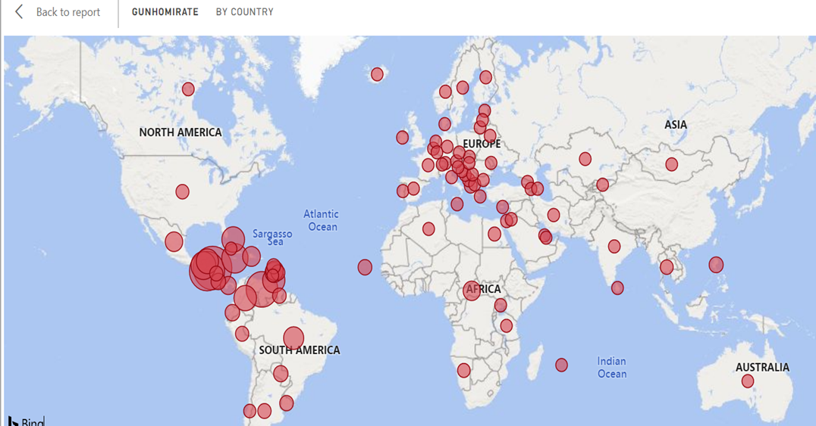
Are gun related homicides distinctly an American Problem?
Gun related homicides are not an American problem as hotspots can be found across the world
Central and Northern South America have the highest concentration of gun related homicide rates
There are several countries in Asia and Africa which were not included in the analysis due to missing information

Slide 9
Conclusion
There is not a strong correlation between the number of guns per captia and the rate of homicides which occur
There is strong evidence to indicate that restricting how firearms can be carried and what types can be owned results in lower rates of homicides
Other factors need to be evaluated to understand why some countries have higher rates of homicide even with more strict gun control policies

Slide 10
References
Cohn, D. V., Taylor, P., Lopez, M. H., Gallagher, C. A., Parker, K., & Maass, K. T. (2020, May 30). Gun Homicide Rate Down 49% Since 1993 Peak; Public Unaware. Pew Research Center's Social & Demographic Trends Project. https://www.pewresearch.org/social-trends/2013/05/07/gun-homicide-rate-down-49-since-1993-peak-public-unaware/.
Gun Violence Statistics. Giffords. (2021, May 29). https://giffords.org/lawcenter/gun-violence-statistics/.
Facts and Figures. (2018). https://health.ucdavis.edu/what-you-can-do/facts.html.
Aizenman, N. (2021, March 24). Gun Violence Deaths: How The U.S. Compares With The Rest Of The World. NPR. https://www.npr.org/sections/goatsandsoda/2021/03/24/980838151/gun-violence-deaths-how-the-u-s-compares-to-the-rest-of-the-world.
World Health Organization. (2020). Estimates of rate of homicides (per 100 000 population). World Health Organization. https://www.who.int/data/gho/data/indicators/indicator-details/GHO/estimates-of-rates-of-homicides-per-100-000-population.
Bureau, U. S. C. (2021, April 20). State Population by Characteristics: 2010-2019. The United States Census Bureau. https://www.census.gov/data/tables/time-series/demo/popest/2010s-state-detail.html.
Howard Bauchner, M. D. (2017, December 1). The Epidemic of Guns. JAMA Psychiatry. https://jamanetwork.com/journals/jamapsychiatry/fullarticle/2657419.
Gittins, W. (2021, March 24). Which states have banned assault rifles in the US? AS.com. https://en.as.com/en/2021/03/24/latest_news/1616614063_422035.html.
Knoema. (n.d.). United Nations Office on Drugs and Crime - UNODC: Data and Statistics. Knoema. https://knoema.com/atlas/sources/UNODC.
Xu, J., Murphy, S., Arias, E., & Kochanek, K. (2021). Deaths: Final Data for 2018, 69(13). https://doi.org/10.15620/cdc:106058

